Slide 1
軟體工程設計 W12
許庭瑋、陳君翰、洪世彬、劉玠均、楊昕叡、林俊佑
2023/12/07

Slide 2
Homework

Slide 3
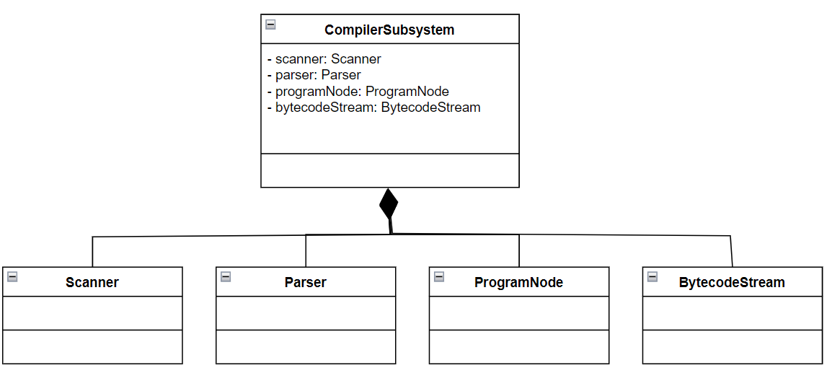
HW1
A compiler subsystem contains classes such as Scanner, Parser, ProgramNode, and BytecodeStream.

Slide 4
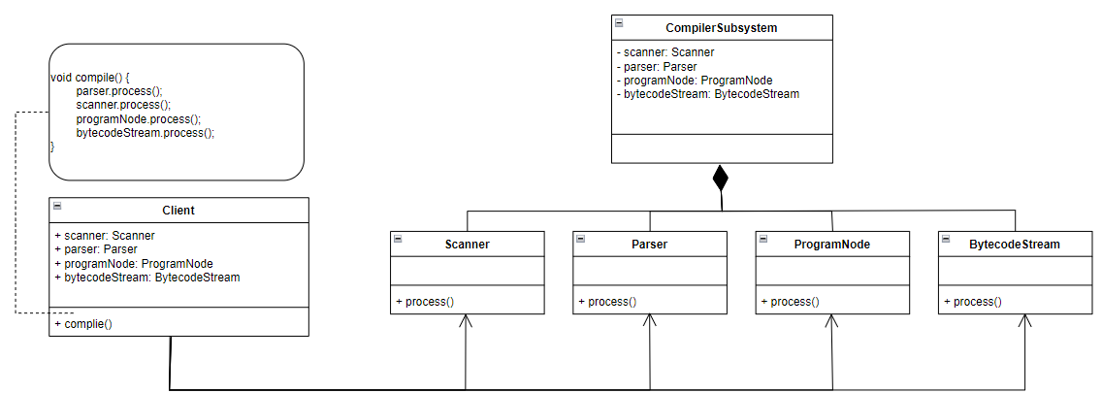
HW1 - initial design
The client classes need to use Scanner, Parser, ProgramNode, and BytecodeStream to compile some code.
Problem: Client has to know well about the process of compiling.

Slide 5
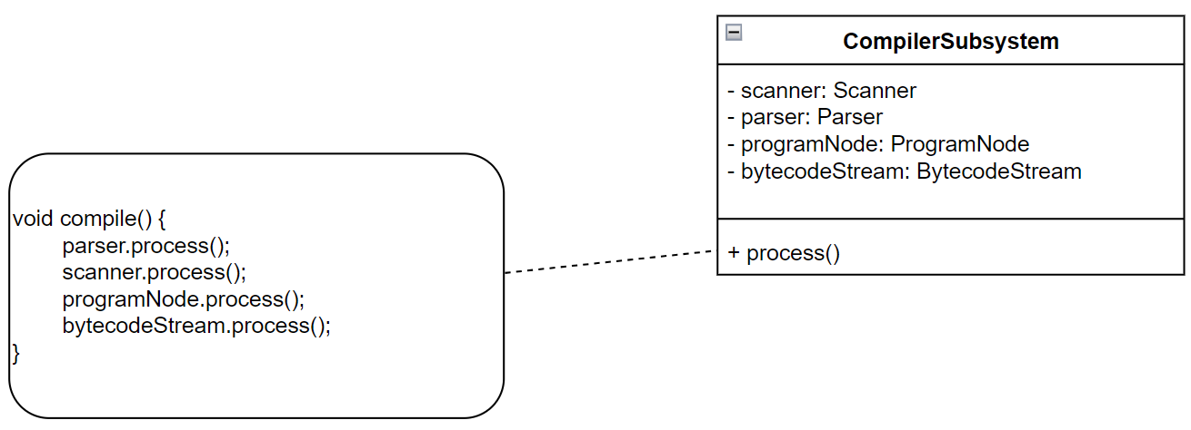
HW1 - Encapsulation

Slide 6
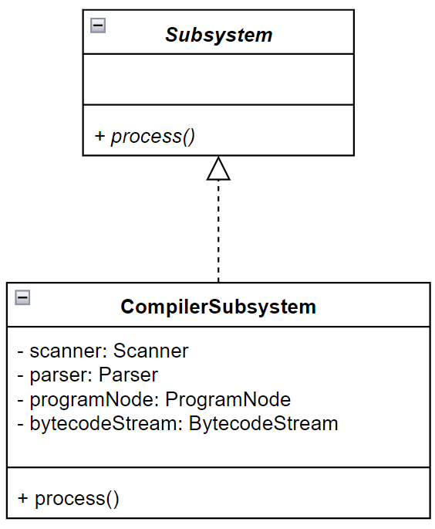
HW1 - Abstraction

Slide 7
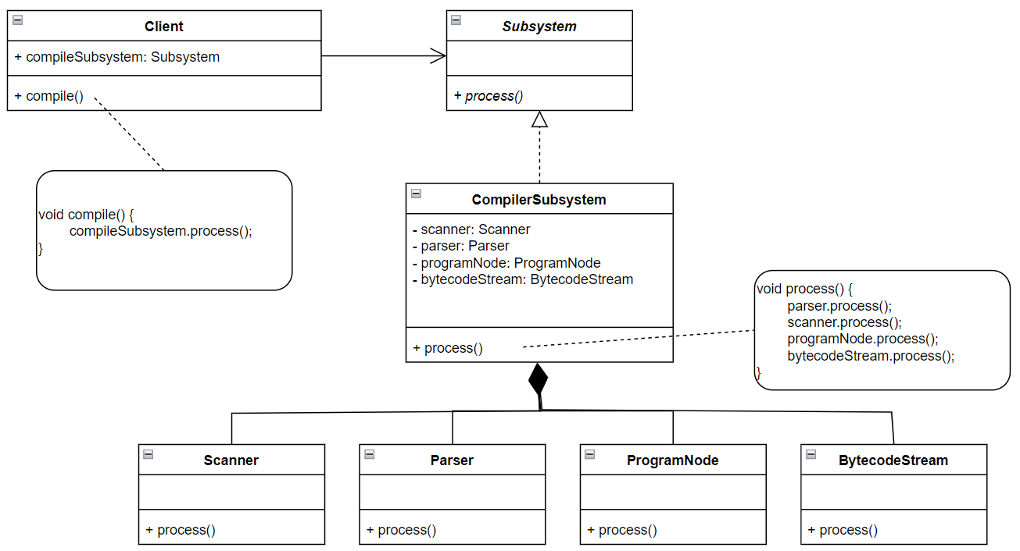
HW1 - Delegation

Slide 8
HW1 - Refactored design

Slide 9
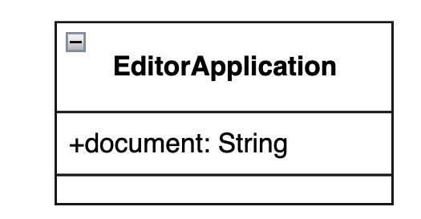
HW2 - CutCopyPaste
An editor application carries a document.

Slide 10
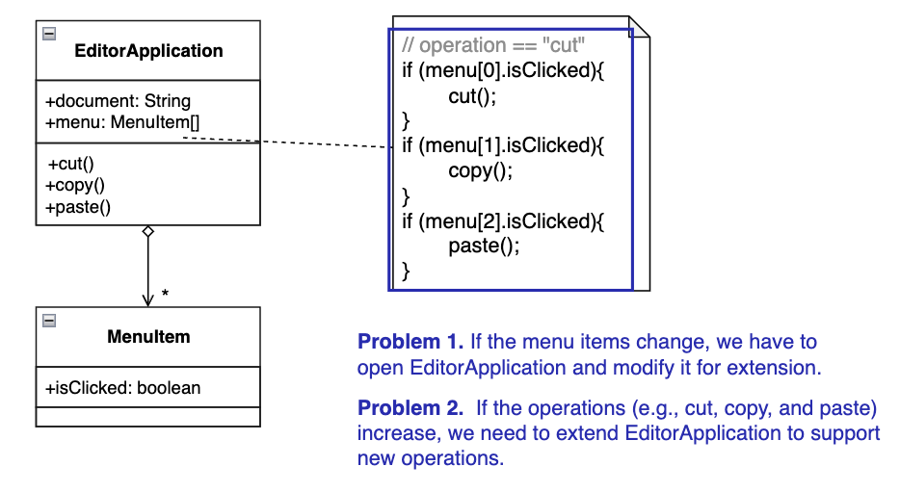
HW2 - CutCopyPaste (Initial Design)
A menu in the editor application contains several menu items performing three specific operations: cut, copy and paste on a document when clicked.

Slide 11
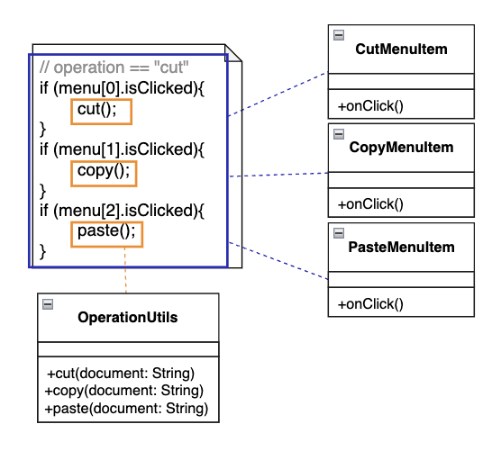
HW2 - Encapsulate What Varies
Encapsulate menu items: CutMenuItem, CopyMenuItem, PasteMenuItem

Slide 12
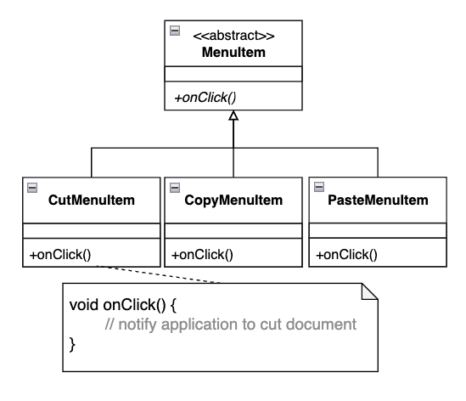
HW2 - Abstract Common Behaviors
Abstract MenuItem

Slide 13
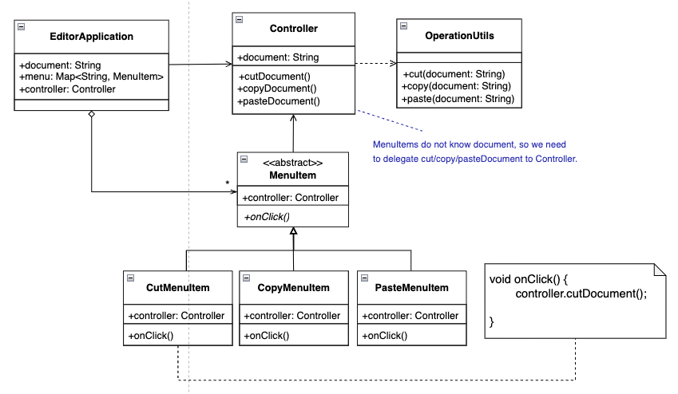
HW2 - Delegate Abstract Behavior (Refactored Design)

Slide 14
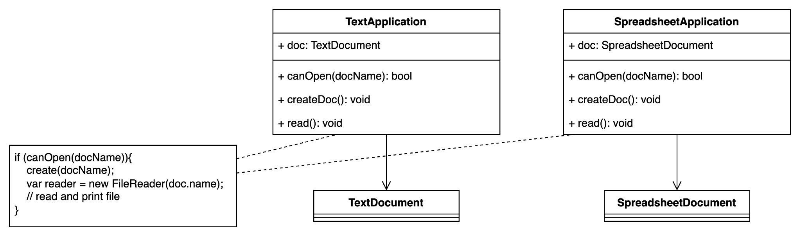
HW3 - initial design

Slide 15
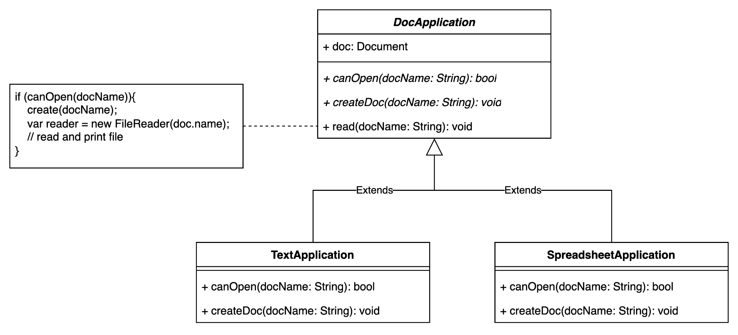
HW3 - encapsulation and abstraction
the application all act the same
check if the document can be opened
create document object and hold the reference
read the document

Slide 16
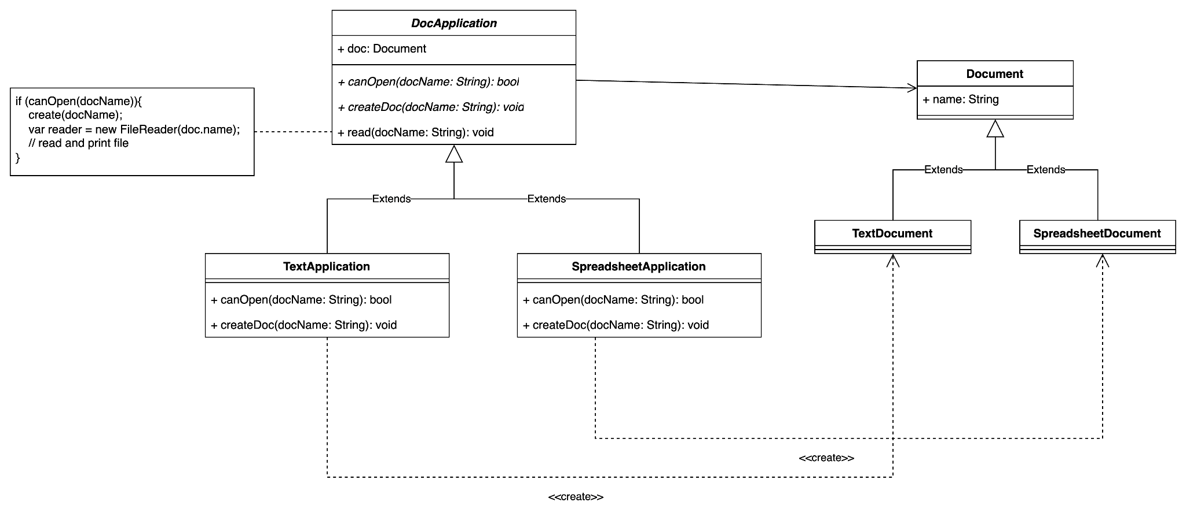
HW3 - final design

Slide 17
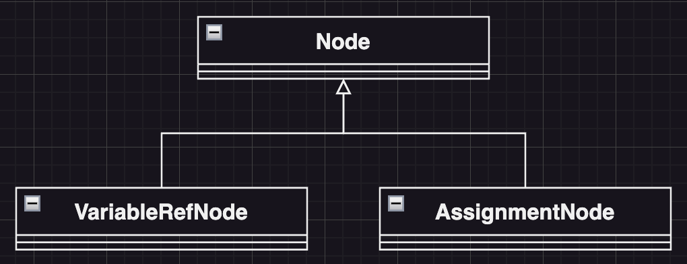
HW4
There are several nodes in an abstract syntax tree (AST), such as VariableRefNode and AssignmentNode, which represent respective parts in source code and keep the code information.

Slide 18
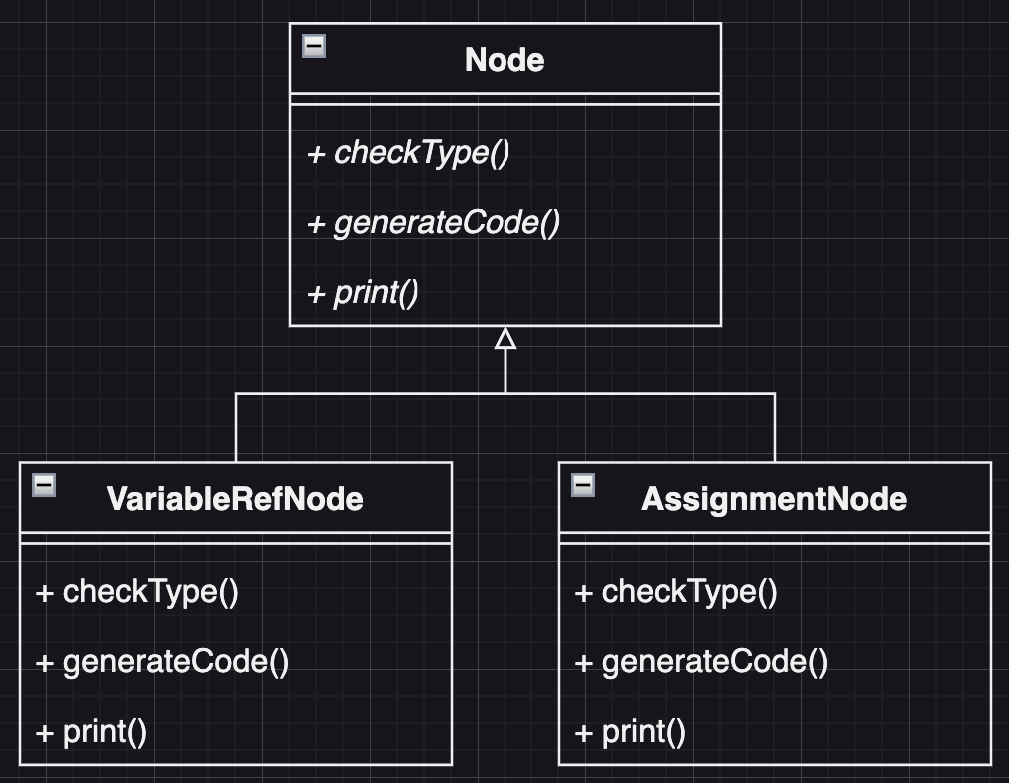
HW4
Each node currently provides three interfaces for the compiler to use in order to check its type, generate code and print out the content.

Slide 19
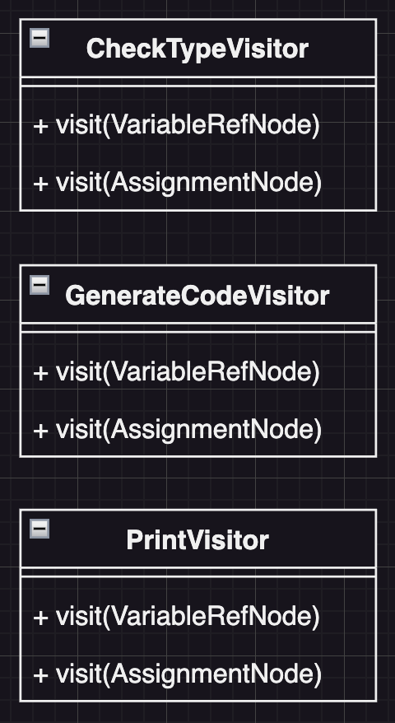
HW4 - Encapsulation

Slide 20
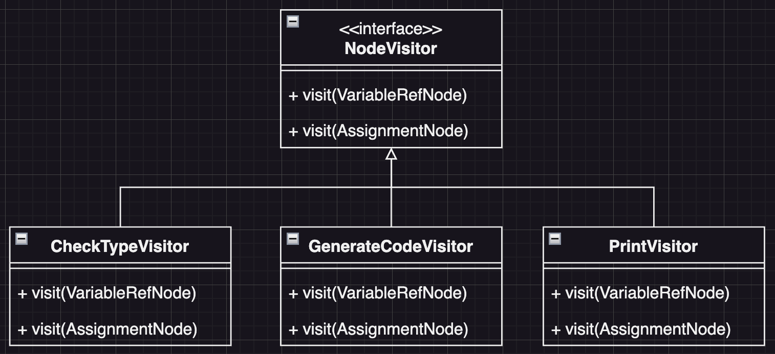
HW4 - Abstraction

Slide 21
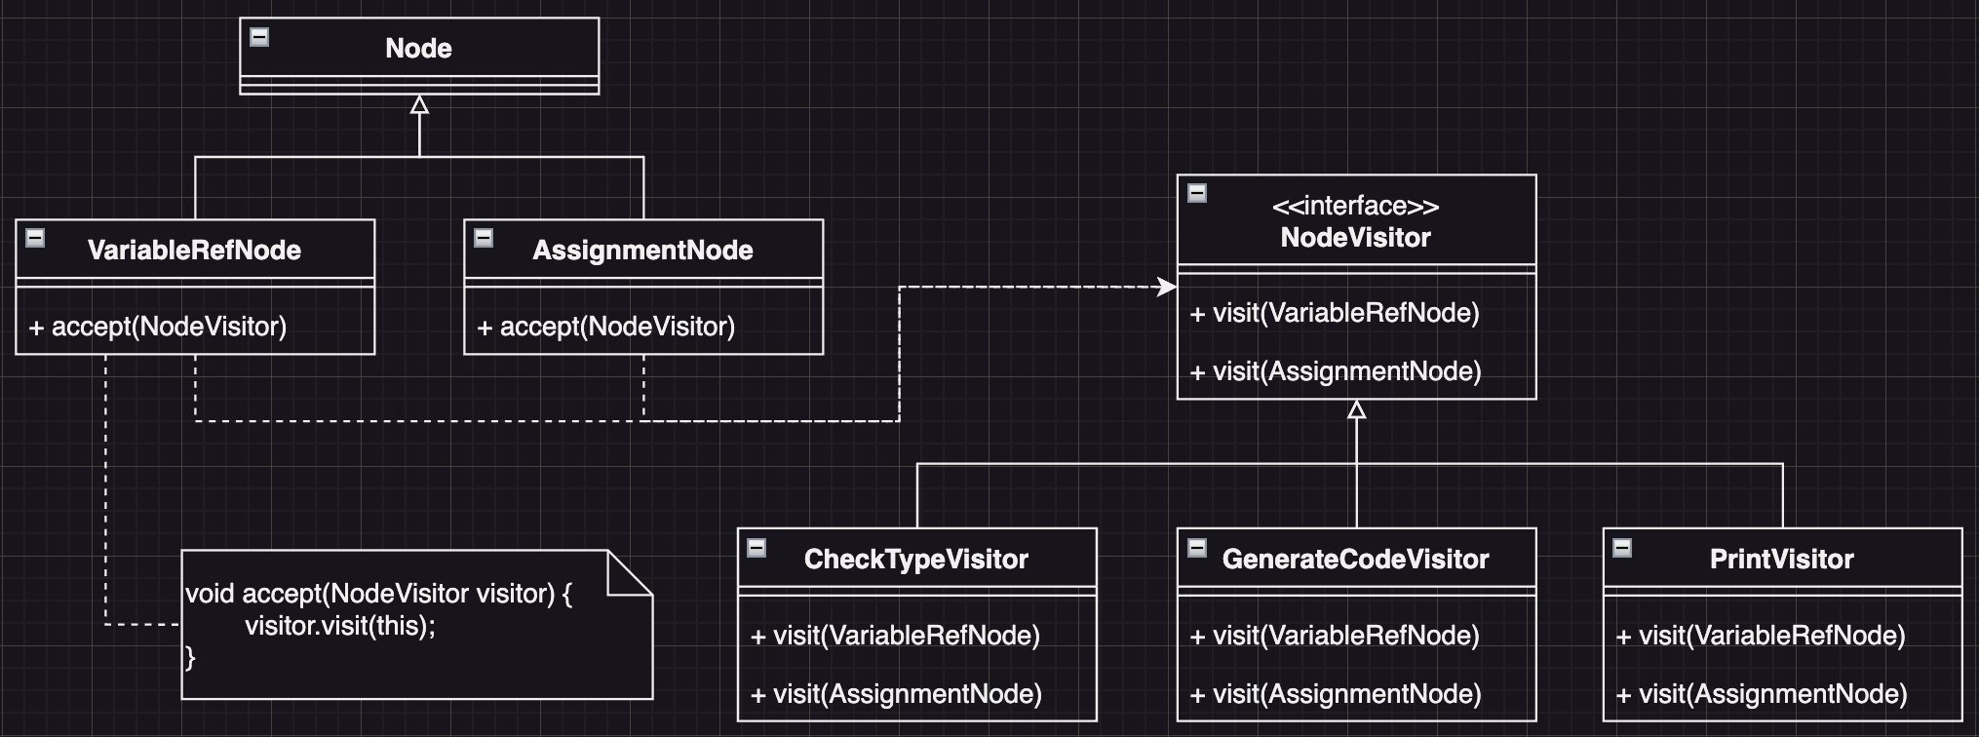
HW4 - Delegation

Slide 22
Code Tracing

Slide 23
Weekly Code Tracing Progress
 | Part | LOC
spring-core-core
許庭瑋 | remain part of support/ | 703
楊昕叡 | AnnotatedMethod.java, IntrospectionFailureLogger.java, SynthesizedMergedAnnotationInvocationHandler.java, SynthesizingMethodParameter.java | 503
劉玠均 | CachingMetadataReaderFactory, SimpleAnnotationMetadata, MergedAnnotationReadingVisitor, ClassVisitor.java | 634
洪世彬 | Constants.java, SimpleAliasRegistry.java, BridgeMethodResolver.java, OrderComparator.java | 512
spring-core-aot, spring-core-cglib
陳君翰 |  | 688
林俊佑 | CGLIB.BEAM | 449

Slide 24
許庭瑋
Support package: Support classes for Spring's resource abstraction
ResourcePatternResolver
an interface, use to resolve a location pattern
ResourcePatternUtils
Utility class for implementing ResourcePatternResolver
getResourcePatternResolver: return new PathMatchingResourcePatternResolve
PropertySourceFactory
an interface, obvious factory pattern

Slide 25
許庭瑋
EncodedResource
combines a Resource descriptor with a specific encoding
getContentAsString: use charset to decode the descriptor
DefaultPropertySourceFactory
very simple implementation of PropertySourceFactory
createPropertySource: return new ResourcePropertySource
PropertiesLoaderSupport
for JavaBean-style components that need to load properties from one or more resources.
loadProperties: Load properties to this.location

Slide 26
許庭瑋
PropertiesLoaderUtils
for loading Properties
fillProperties: use PropertiesPersister to load resource by Properties.
loadAllProperties: use ClassLoader to get urls from resourceName, then use Properties.load to load data from URLConnection
PropertySourceDescriptor
Descriptor for a PropertySource
PropertySourceProcessor
Contribute property sources to the Environment
constructor injection: inject ResourceLoader

Slide 27
許庭瑋
PropertySourceProcessor
processPropertySource: for location in descriptor.locations, use resolveRequiredPlaceholders and addPropertySource to process PropertySourceDescriptor
ResourceArrayPropertyEditor
Editor for Resource arrays, convert string into location patterns
resolvePath: use propertyResolver.resolveRequiredPlaceholders to resolve the given path
setValue: convert value to a Resource array

Slide 28
許庭瑋
ResourcePropertySource:
Subclass of PropertiesPropertySource that loads Properties from a given Resource or resource location
so many constructors(9)
LocalizedResourceHelper
Helper class for loading a localized resource
findLocalizedResource: decide location from input and return Resource

Slide 29
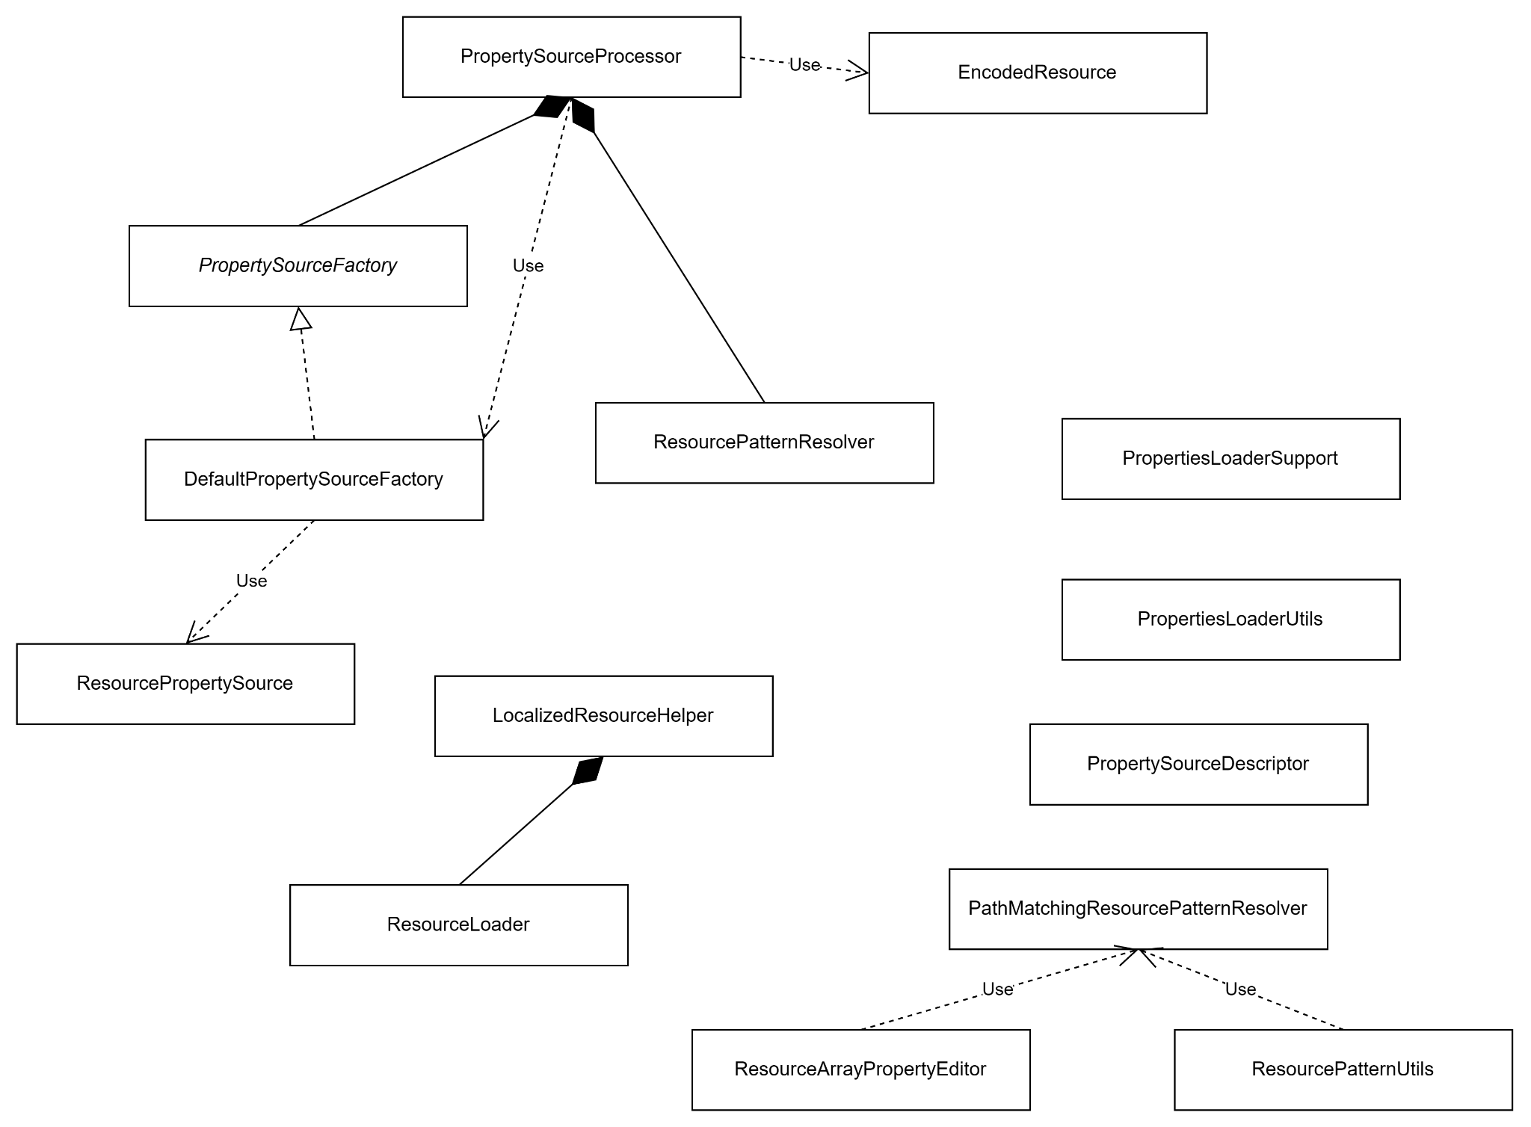
許庭瑋
UML this week:

Slide 30
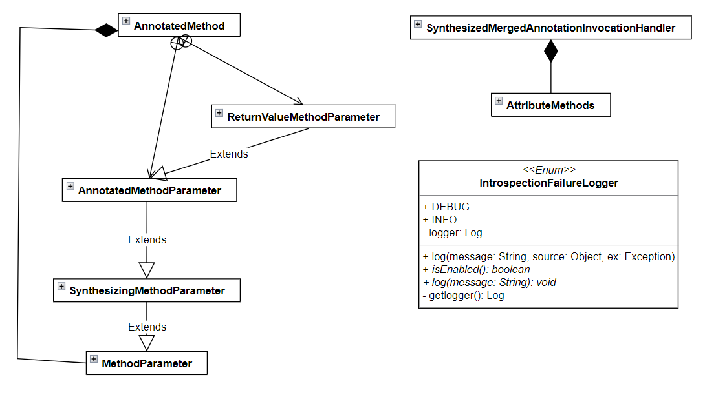
楊昕叡
class diagram: full version

Slide 31
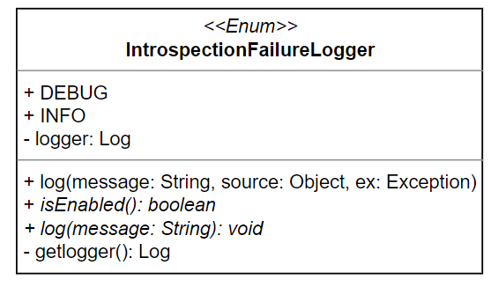
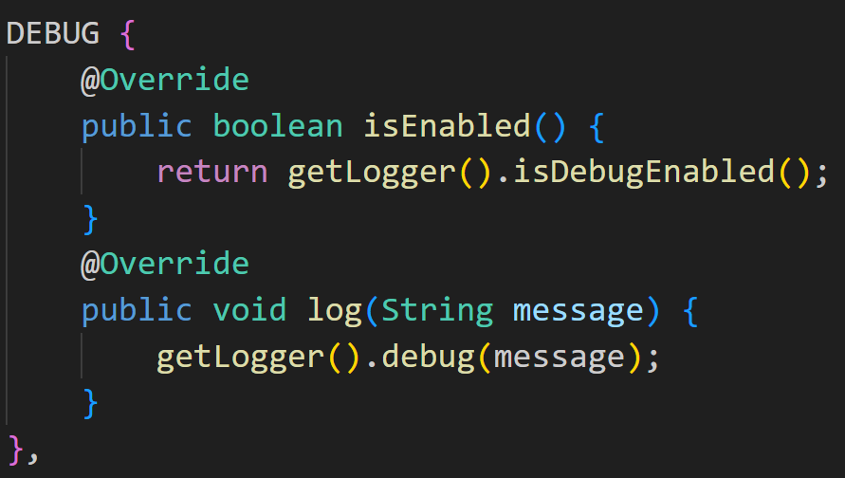
楊昕叡
enum IntrospectionFailureLogger
This enum provides two choices for logger: DEBUG and INFO, which implements abstract methods isEnabled() and log(). It is also a singleton pattern, ensuring that both DEBUG and INFO have only one instance.

Slide 32
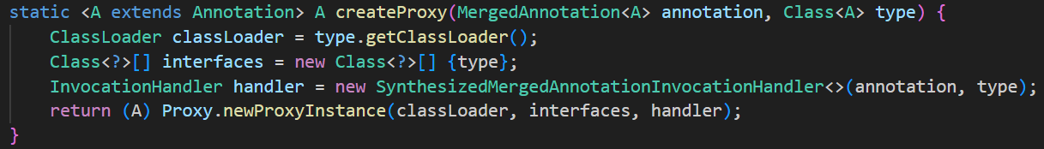
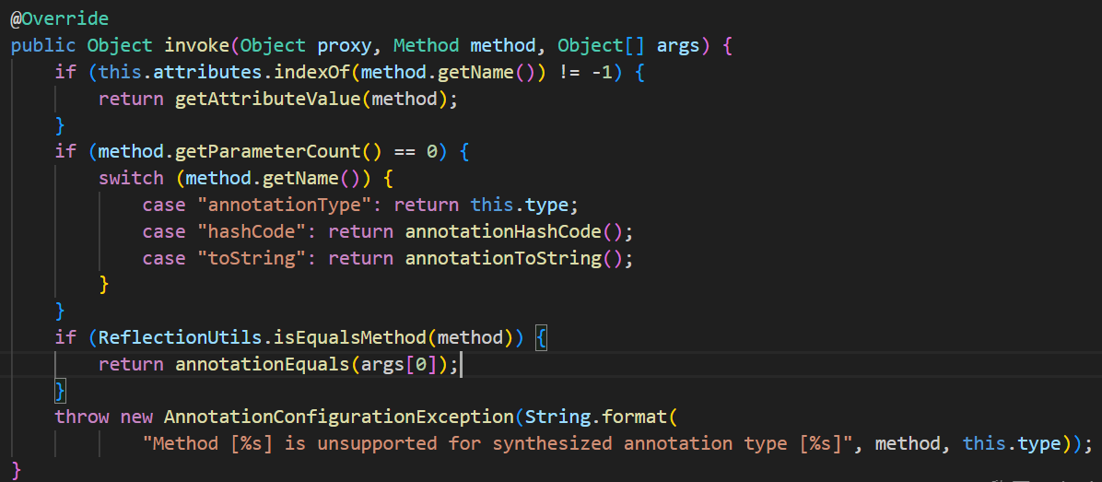
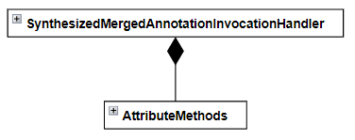
楊昕叡
final class SynthesizedMergedAnnotationInvocationHandler<A extends Annotation> implements InvocationHandler
This class’s constructor is private and uses proxy pattern to handle methods related to annotations (hashcode, strings of attributes’ names & values…).

Slide 33
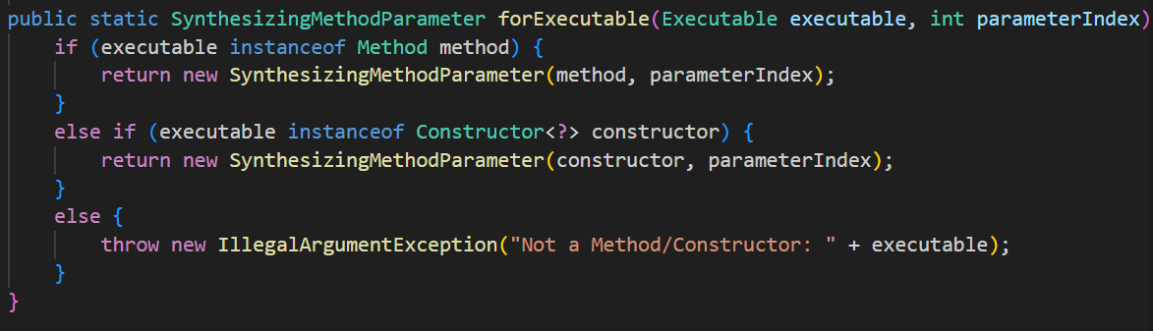
楊昕叡
public class SynthesizingMethodParameter extends MethodParameter
MethodParameter is a class encapsulating a method/constructor ‘s parameter, and SynthesizingMethodParameter is for annotations with attribute aliases via @AliasFor.
The instance of this class can be created through constructors or forExecutable(), which takes methods and constructors as Executables.

Slide 34
楊昕叡
public class AnnotatedMethod
This class encapsulates annotations on a method and its parameters.
All attributes in this class can’t be modified after constructed, so an instance of this class is an immutable object.

Slide 35
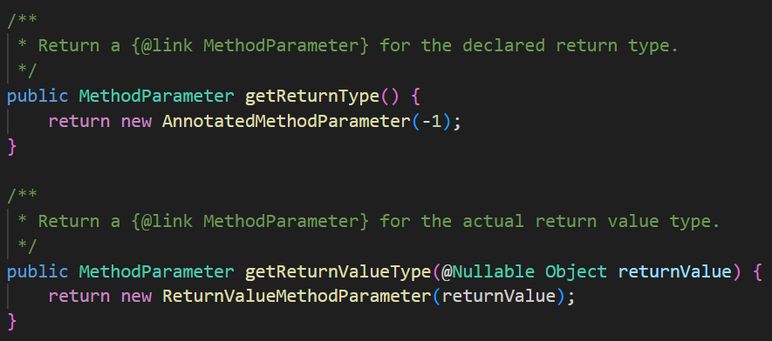
楊昕叡
protected class AnnotatedMethodParameter extends SynthesizingMethodParameter
This inner class acts as almost all the returned MethodParameter in AnnotatedMethod.
private class ReturnValueMethodParameter extends AnnotatedMethodParameter
This inner class is a MethodParameter for an AnnotatedMethod return type based on the actual return value.

Slide 36
劉玠均
Class diagram full version
type/classreading contains various types of Visitors for visiting Annotations, Methods, and Classes.
For example, this week,
SimpleAnnotationMethodReadingVisitor
MergedAnnotationReadingVisitor
are Class visitor and Annotation visitor respectively.

Slide 37
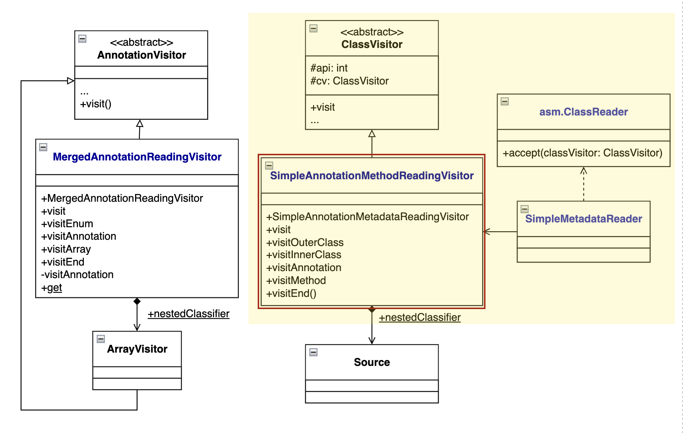

Slide 38
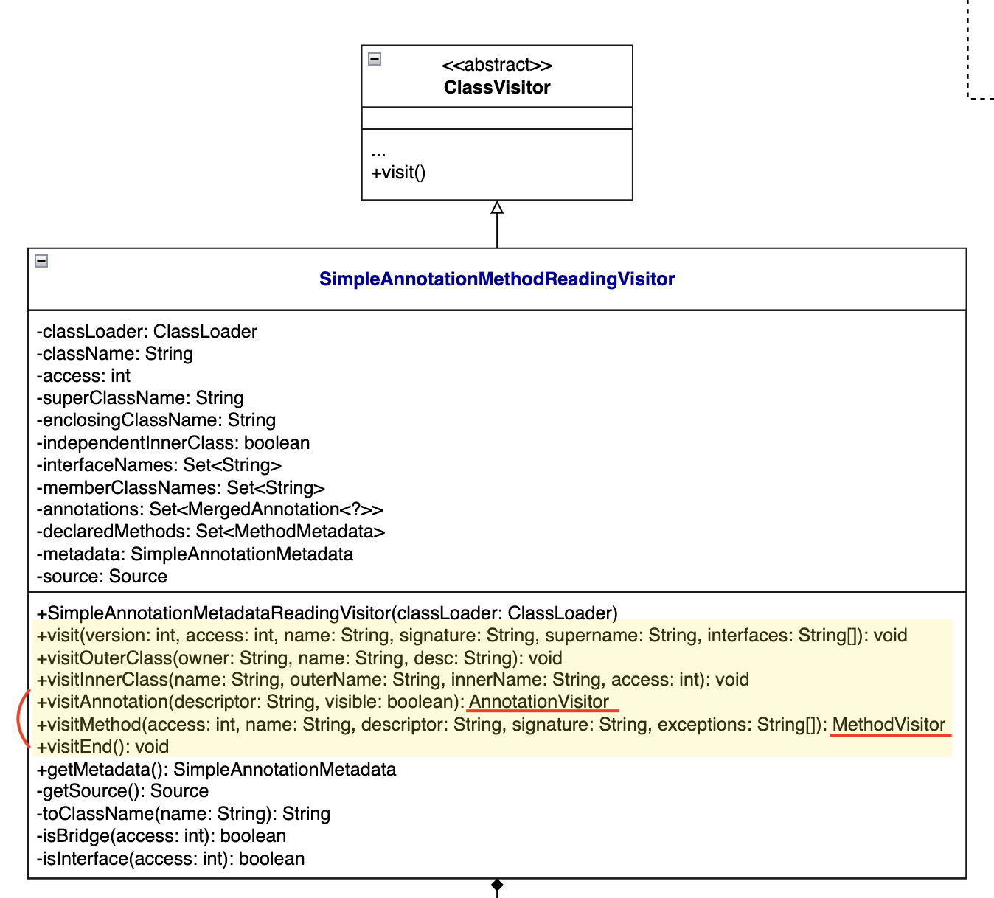
劉玠均 - SimpleAnnotationMethodReadingVisitor
It defines 6 visit functions: visit, visitOuterClass, visitInnerClass, visitAnnotation, visitMethod, and visitEnd.
Among them, visitMethod and visitAnnotation delegate their jobs to other visitors (marked by red line).

Slide 39
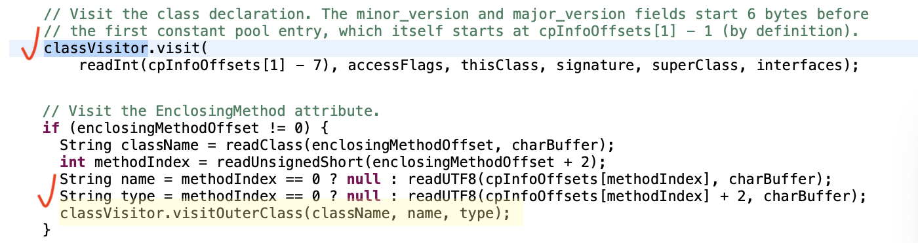
劉玠均 - SimpleAnnotationMethodReadingVisitor
Revisit the code pieces in SimpleMetadataReader presented last week.
These visit functions are used in asm.ClassReader.accept(classVisitor…)

Slide 40
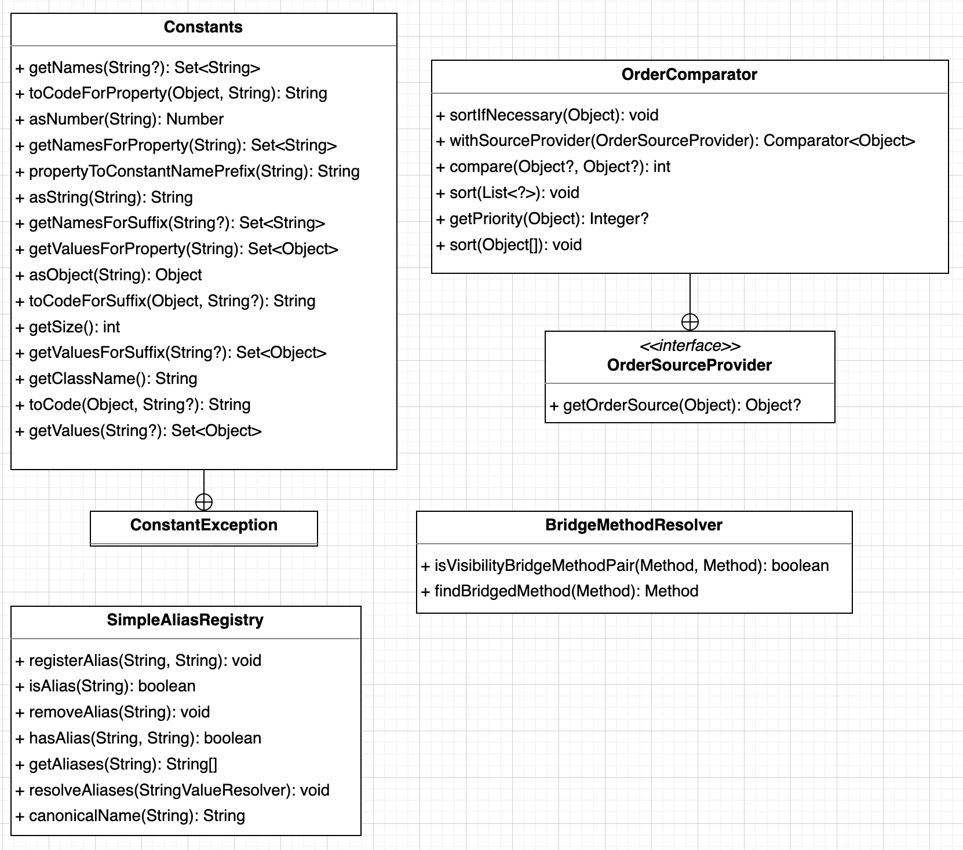
洪世彬
On the right side are the classes I've studied this week. Similar to last week, there isn't much correlation between the classes.

Slide 41
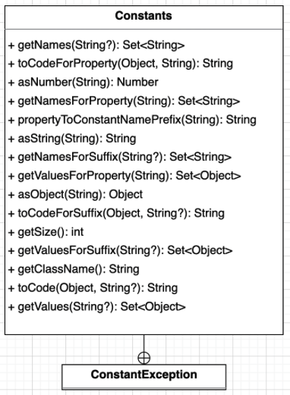
洪世彬
Constants is a class that is about to be deprecated.
Its main function is to allow developers to quickly access public static final members defined within a class. When creating it, you need to pass the class you want to observe into the constructor, and then you can use the methods defined in it to retrieve relevant information.

Slide 42
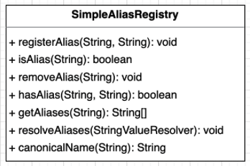
洪世彬
SimpleAliasRegistry inherits from AliasRegistry and provides functionality for alias registration. You can use registerAlias to register aliases for corresponding names.

Slide 43
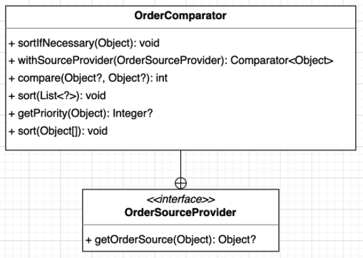
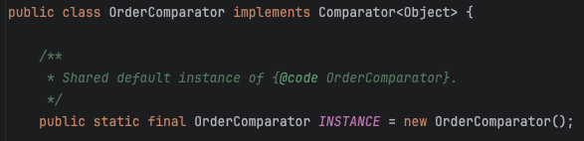
洪世彬
OrderComparator inherits from Comparator and provides sorting functionality based on the 'Ordered' interface.
When sorting, it arranges the elements in ascending order based on the values provided by 'Ordered.'
Since OrderComparator is a general utility class, it uses the singleton pattern to define a single instance.

Slide 44
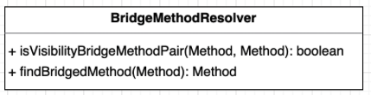
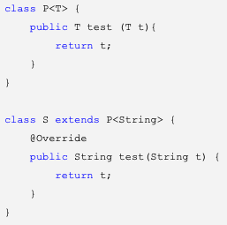

洪世彬
BridgeMethodResolver is a class used to find BridgeMethods.
BridgeMethods are used to address override issues with generic objects. They are automatically generated during compilation to fulfill the required BridgeMethods.
User Defined Method
BridgeMethod Generated by compiler

Slide 45
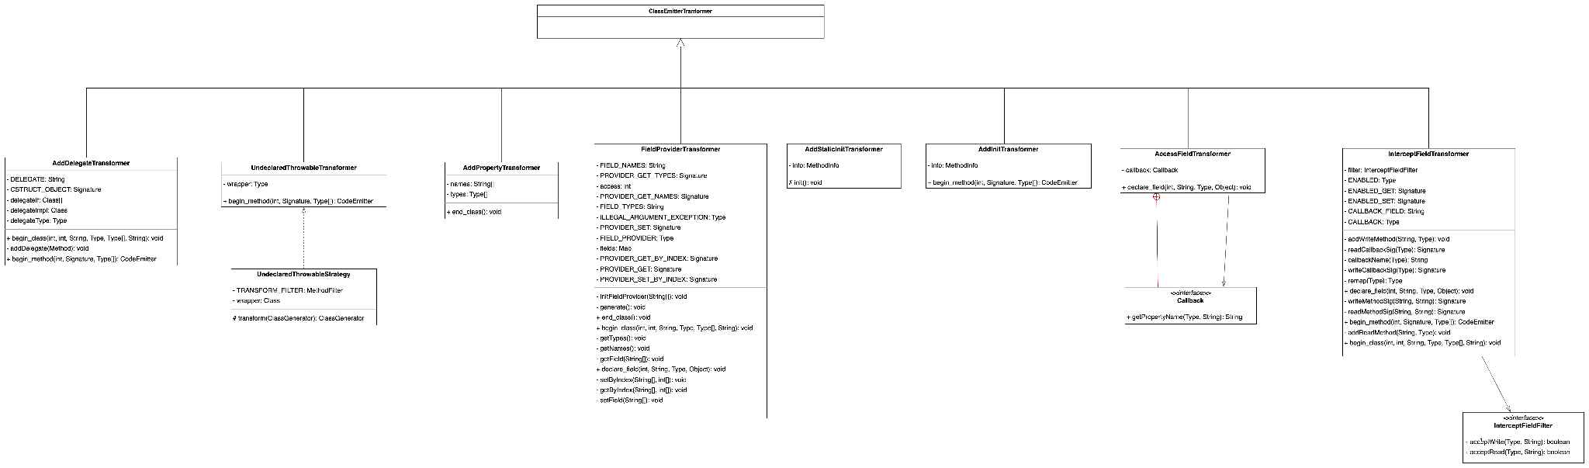
陳君翰
package 為 cglib.transform.impl，為整個 Transformer 的實作部分
8 個 ClassEmitterTransformer 的子類別，但 ClassEmitterTransformer 就是個空殼子，主要還是要看更上層的 ClassEmitter

Slide 46
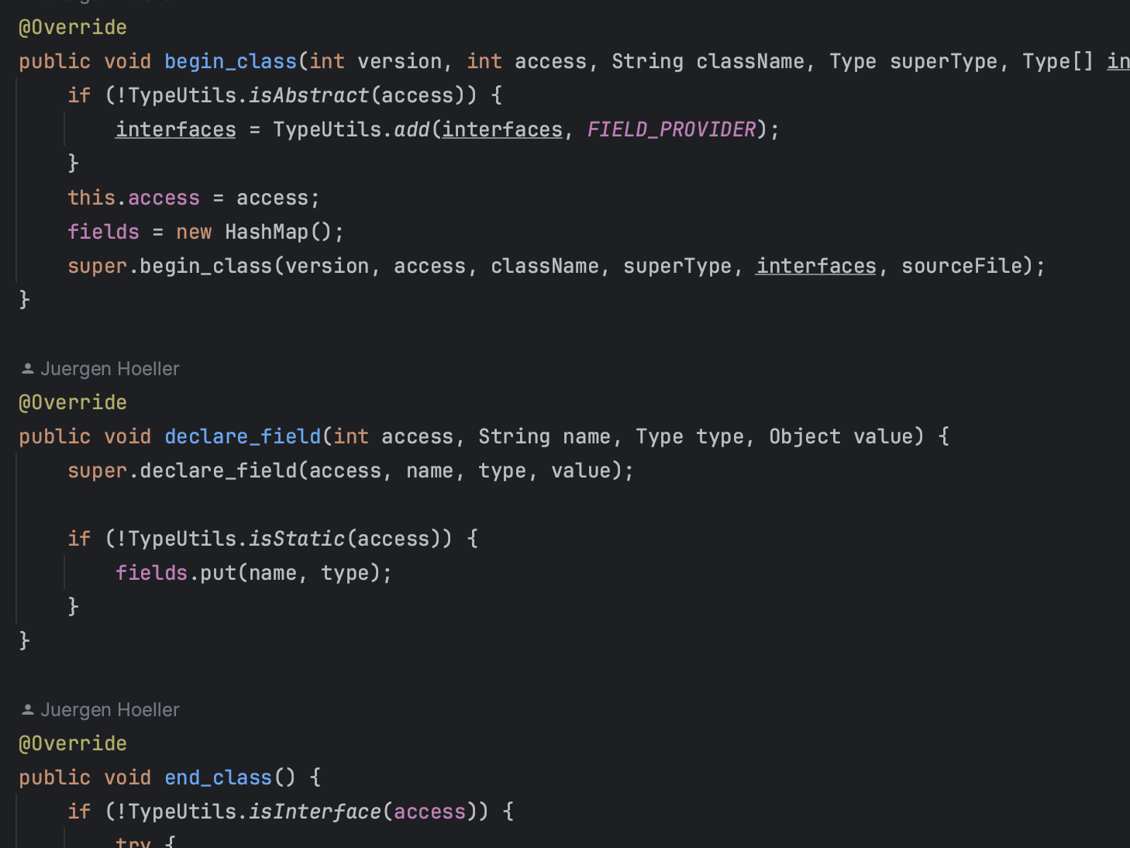
陳君翰
確實是在實作各種 transformer
這幾個子類別個別在擴充 ClassEmitter 的 begin_class(), end_class(), begin_method(), begin_static(), declare_field()，其中穿插拿各種 emitter 去執行，改造 Class 中不同的區段（property, different methods, getter and setter, etc.）

Slide 47
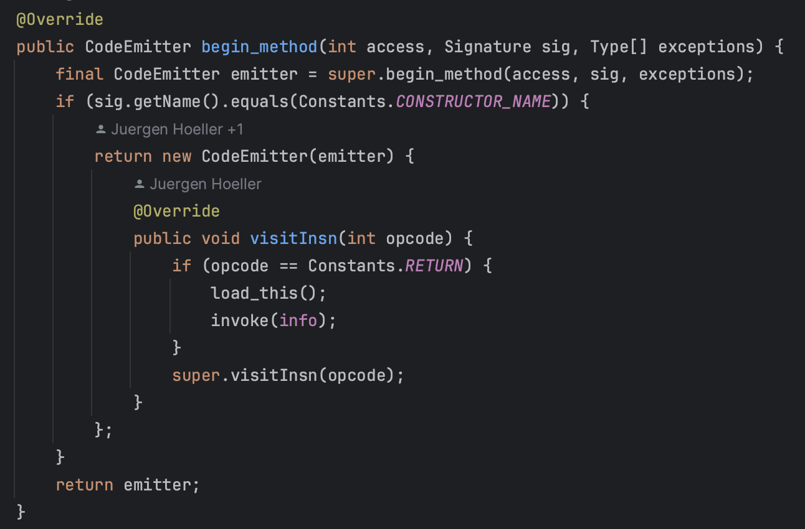
陳君翰
比較有趣的寫法是在 new 一個 Object 時去 override 他內部的 method，這可以避免去多生成一個新的 Class，浪費資源

Slide 48
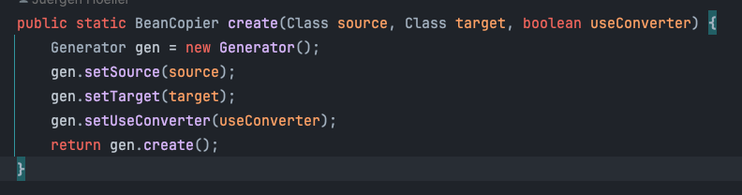
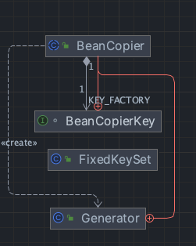
林俊佑
BeanCopier
基於 Generater 的實作, Generate 是繼承自 AbstractClassGenerator

Slide 49
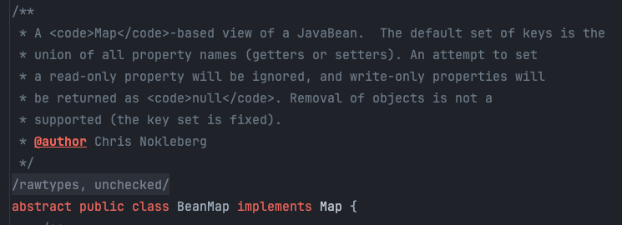
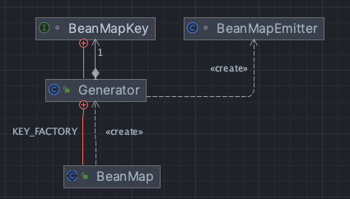
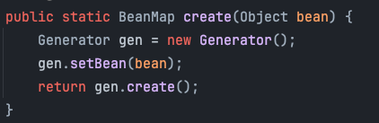
BeanMap
基於 Generater 的實作, Generate 是繼承自 AbstractClassGenerator
整體是繼承 Map 方法的實作, 此外因為 Generator 較複雜, 委派 Emitter 完成

Slide 50
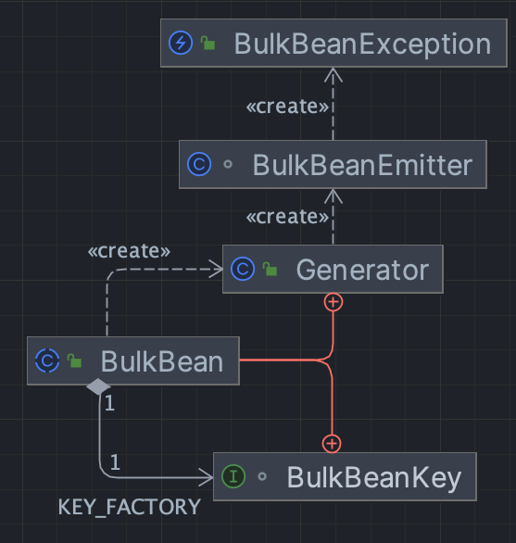
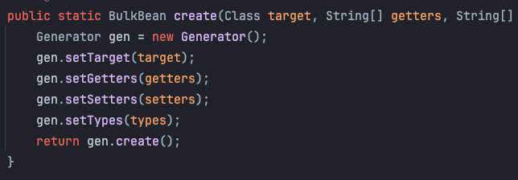
BulkBean
基於 Generater 的實作, Generate 是繼承自 AbstractClassGenerator
BulkBeanEmitter 繼承 ClassEmitter, 被委派來操作 asm api

Slide 51
concept
classA
ClassB
ClassC
inner
inner
inner
abstractionGenerator

